Slide 1
MUSHROOM CLASSIFICATION DETAILED PROJECT REPORT (DPR)
AUTHOR : Aishik Chatterjee

Slide 2
ABSTRACT
Mushrooms have been consumed since earliest history. The word Mushroom is derived from the French word for Fungi and Mold. Now-a-days, Mushroom are popular valuable food because they are low in calories, carbohydrate, Fat, sodium and also cholesterol free. Besides this, Mushroom provides important nutrients, including selenium, potassium, riboflavin, niacin, Vitamin D, proteins and fiber. All together with a long history as food source. Mushroom are important for their healing capacity and properties in traditional medicine. It has reported beneficial effects for health and treatment of some disease. Many nutraceutical properties are described in Mushroom like cancer and antitumor attributes. Mushroom act as antibacterial, immune system enhancer and cholesterol lowering Agent. Additionally, they are important source of bio-active compounds. This work is a machine learning model that classifies mushrooms into 2 classes: Poisonous and Edible depending on the features of the mushroom. During this machine learning implementation, we are going to see which features are important to predict whether a mushroom is poisonous or edible.

Slide 3
INTRODUCTION
Purpose of Detailed Project Report (DPR)
A detailed project report is a very extensive and elaborative outline of a project, which includes essential information such as the resources and tasks to be carried out in order to make the project turn into a success. It can also be said that it is the final blueprint of a project after which the implementation and operational process can occur.
In this comprehensive project report, we will discuss about the end to end implementation of Mushroom Classification with necessary details like Architecture, Data Visualization, Data Preprocessing, Model Building, Model Performance and Deployment of this project with sample test cases.

Slide 4
Problem Statement
The Audubon Society Field Guide to North American Mushrooms contains descriptions of hypothetical samples corresponding to 23 species of gilled mushrooms in the Agaricus and Lepiota Family Mushroom (1981). Each species is labelled as either definitely edible, definitely poisonous, or maybe edible but not recommended. This last category was merged with the toxic category. The Guide asserts unequivocally that there is no simple rule for judging a mushroom's edibility, such as "leaflets three, leave it be" for Poisonous Oak and Ivy.
The main goal is to predict which mushroom is poisonous & which is edible.

Slide 5
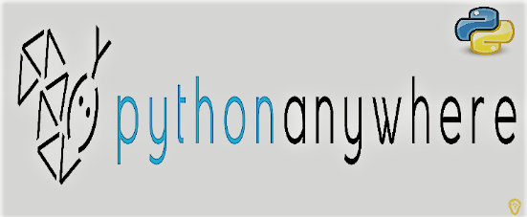
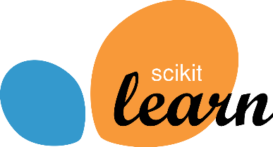
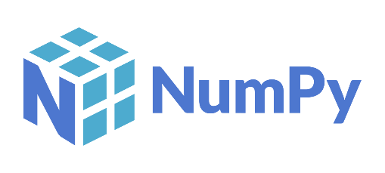
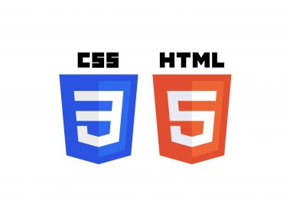
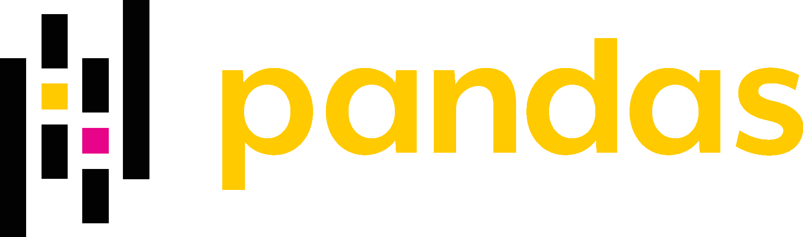
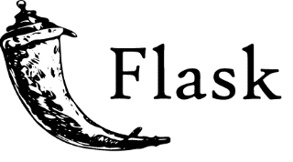
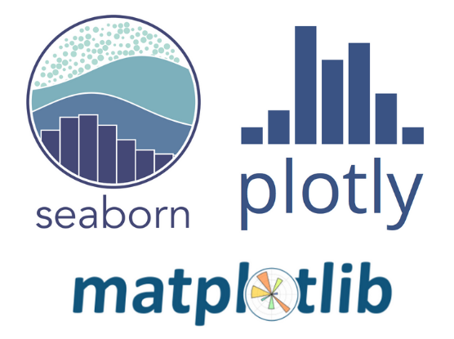


Tools Used

Slide 6
Architecture Design
Start
Import required libraries
Import Dataset
Exploratory Data Analysis
Train / Test Split
Data Preprocessing
Data Visualization
Handling Missing Data
Feature Selection
Train Model
Predict on Test Data
Evaluate Model
Deployment on PythonAnyware
Flask App
HTML and CSS
Save the model using Pickle
Data from User
Predict Result
End

Slide 7
Architecture Description
Data Collection
The data for this project is collected from the Kaggle Dataset, the URL for the dataset is given below: https://www.kaggle.com/datasets/uciml/mushroom-classification.
Data Description
This dataset includes descriptions of hypothetical samples corresponding to 23 species of gilled mushrooms in the Agaricus and Lepiota Family Mushroom drawn from The Audubon Society Field Guide to North American Mushrooms (1981). Each species is identified as definitely edible, definitely poisonous, or of unknown edibility and not recommended. This latter class was combined with the poisonous one.
Exploratory Data Analysis
There are 8124 rows and 23 columns in this data. All the columns are of categorical type. There are two classes present in our target column which are 'p' - poisonous and 'e' - edible.
Handling Missing Data
At first, we observed that there no missing/null values in the dataset. However, if you go through the data description (check the link) you will find that the missing values in one column is replaced with "?". There are 2480 missing values in 'stalk-root' column. First, we will replace these values with np.nan so that we can handle missing data. we will impute the missing values in 'stalk-root' column using sklearn SimpleImputer with strategy='most_frequent'.

Slide 8
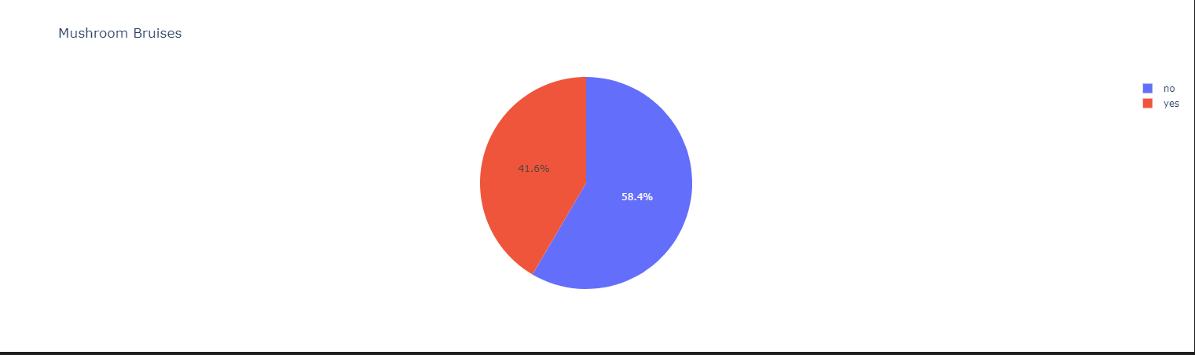
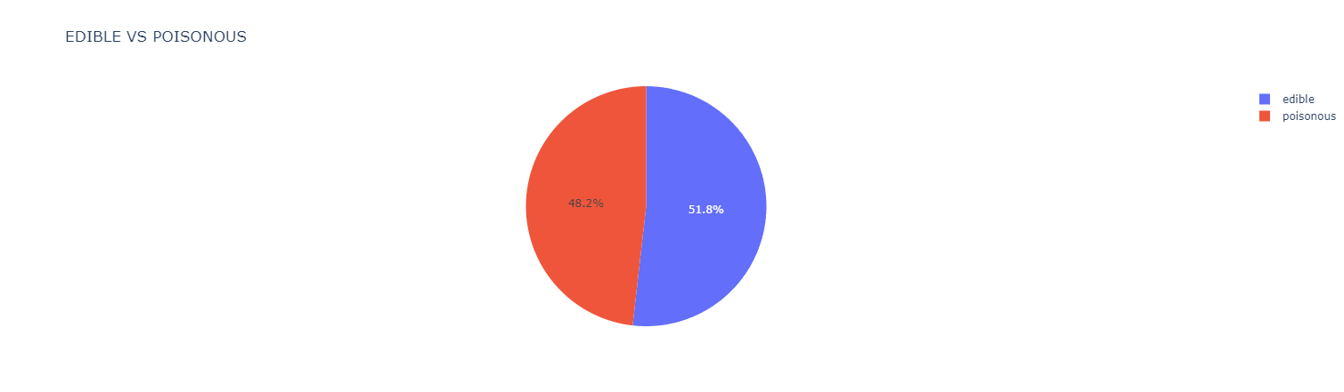
Data Visualization

Slide 9
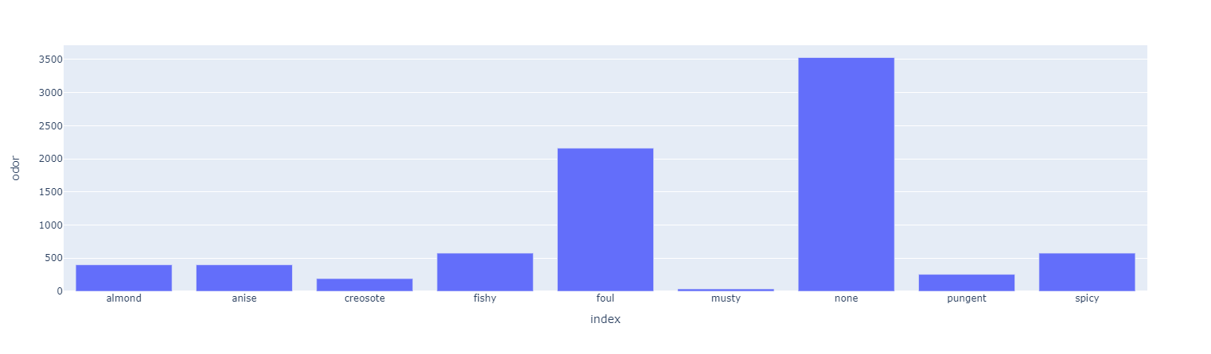
Data Visualization (continued..)

Slide 10
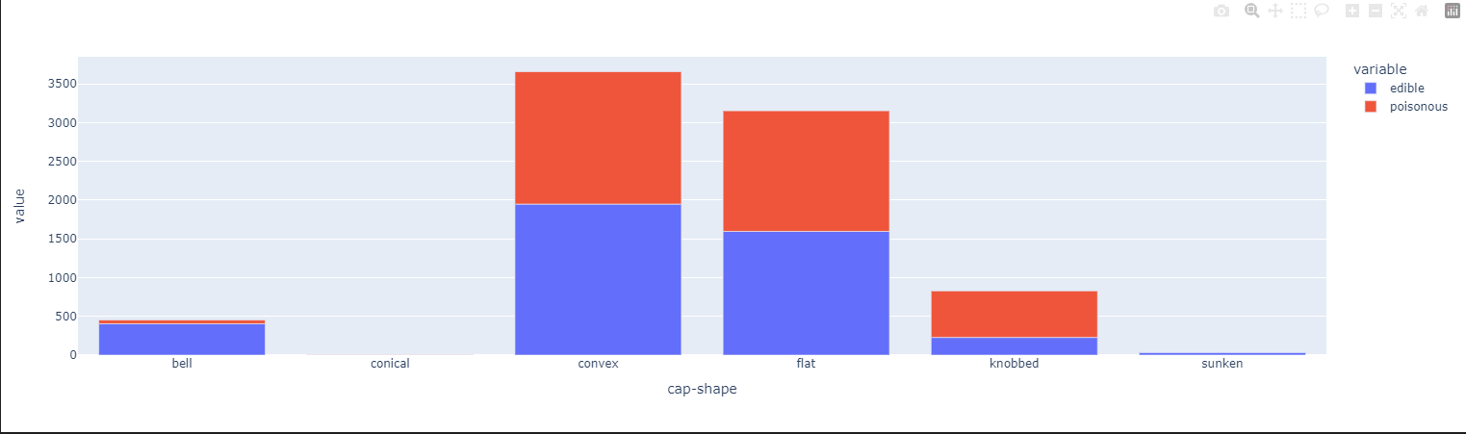
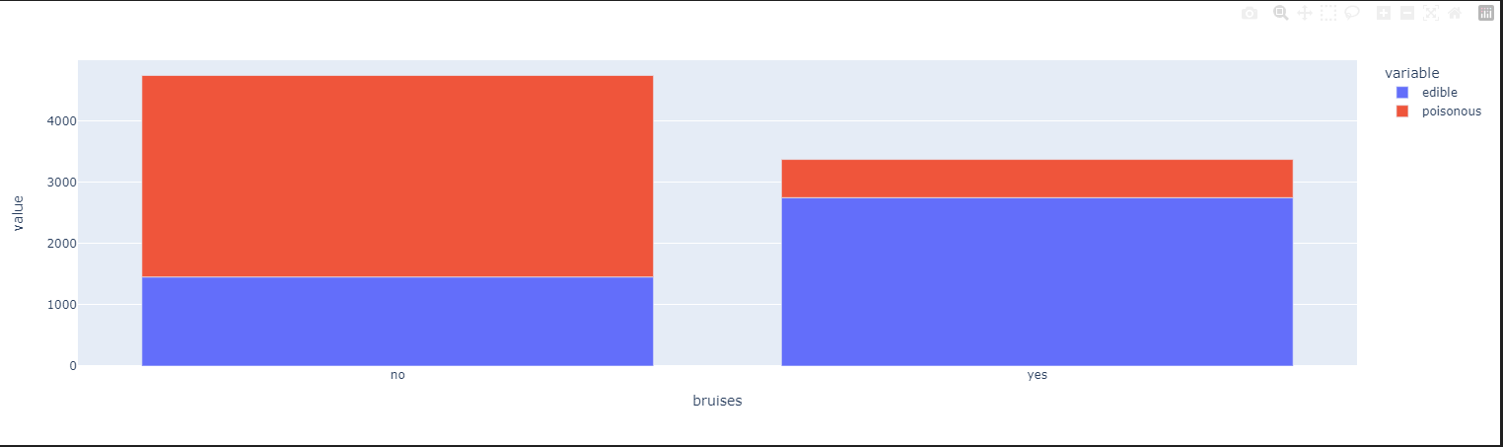
Data Visualization (continued..)

Slide 11
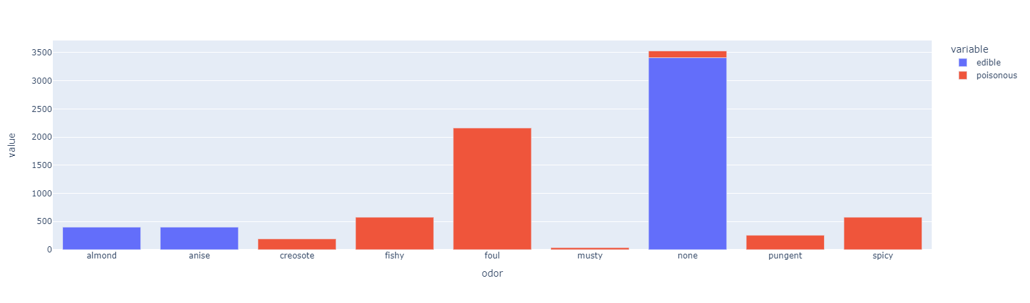
Data Visualization (continued..)

Slide 12
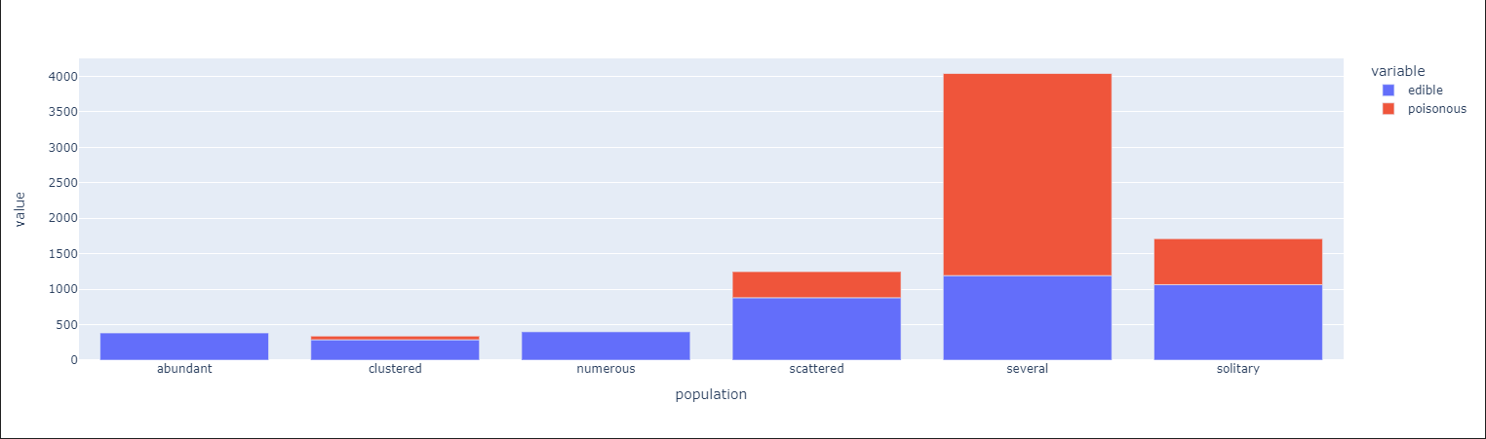
Data Visualization (continued..)

Slide 13
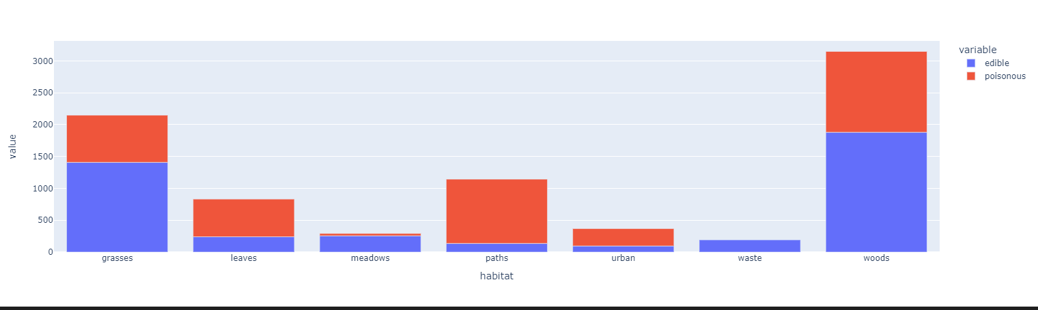
Data Visualization (continued..)

Slide 14
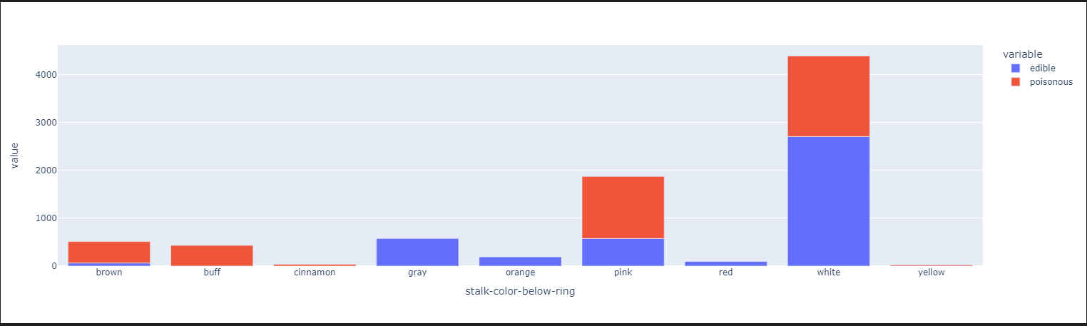
Data Visualization (continued..)

Slide 15
Architecture Description (continued..)
Data Preprocessing
In this step, first we have dropped the column 'veil-type' as it has only one value throughout the data. So, it won't give us much information regarding the class of the mushroom. Next, we mapped our target column to 0 (poisonous) & 1 (edible) values. We used Label Encoder to convert categorical values to numerical then we scaled our data to bring them to same class.
Feature Selection
After splitting the data into train and test set, we use Decision Tree Classifier to identify the best features for our model .
Model Training & Evaluation
We used Decision Tree Classifier as a model for model training it was very fast compared to the other models and it produced 100% accuracy on train data as well as on test data which is a very good for our project.
Model Deployment
We created a webpage using HTML and CSS. We created a Flask web app and first tested in on our local machine. Then we deployed our model using PythonAnyware. We used different combination of input and predicted the output, and the results were accurate. The app was working fine and there were no issues found

Slide 16
Web Interface
App Link : https://aishik1.pythonanywhere.com/

Slide 17
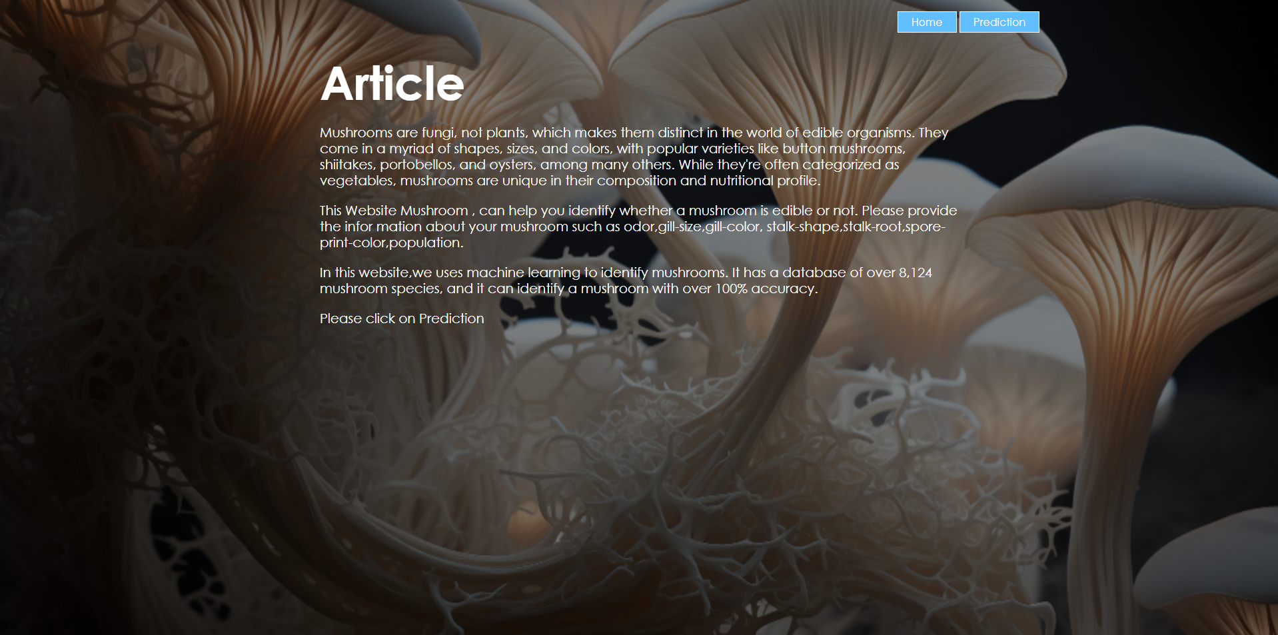
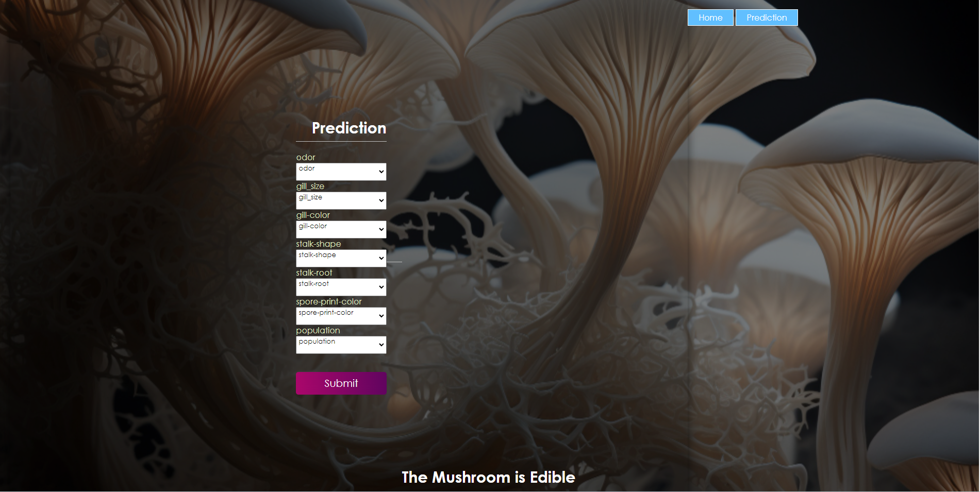
Test Cases
Poisonous Mushroom
Predicted Output

Slide 18
Summary :
* Data authentication: The source of data is iNeuron.ai .The data is good for analysis
* Data bias : After analyzing data it looks like data is not bias .
1. The target column has 2 class type one is 'poisonous' which has 3916 counts and second is 'edible' which has 4208 counts, so we have nearly equal counts for poisonous and edible classes in our data. Hence we can say that our data is balanced.
2. There are 4 types of cap-surface in a mushroom and also it suggests that 'edible' mushrooms do not have 'cap-surface' : 'g : grooves' according to our data.
3. 51.8 % Mushrooms are Edible.
4. Some people think that all blue bruising mushrooms are safe to eat or are hallucinogenic. The bolete rule above proves that is not true. This myth is an example of why identifying mushrooms through bruising alone is a bad idea.(source google = 'https://www.mushroom-appreciation.com/identifying-mushrooms.html#:~:text=The%20spores%20and%20stem%20turn,alone%20is%20a%20bad%20idea!')
5. 3528 mushrooms doesn't have odor
6. cap-shape sunken mushrooms in this dataset is not poisonous in nature where conical is poisonous in nature . other are mixed.
7. Mushrooms with out Bruises have higher chance of being poisonous while with bruises have lower chance being poisonous.
8. mushrooms with almond and anise is edible and no odor is high chance bring edible . Other odor is not recommended for eating
9. abundant and numerous population class are edible according to this data where other are mixed .
10.The 'poisonous' mushrooms do not have Habitat Type as Waste according to this data.
10. stalk color Gray,Orange,Red are completely edible and buff,cinnamon,yellow are poisonous . brown have higher chance of being poisonous .

Slide 19
Q & A
What was the type of data ?
The data was of categorical type.
What is the complete flow of this project ?
Please refer to Architecture and it’s description.
How many features were used during deployment ?
We used only 12 features out of 21 to predict our output.
Which cloud platform was used for deployment ?
PythonAnyware was used as a cloud platform to deploy this project.
Is your model 100% sure about whether mushroom is edible or poisonous ?
Looking at the results, yes we are sure. However, it is recommended that you also take help from someone who is expert as some characteristics are same for edible and poisonous mushrooms.

